Slide 1
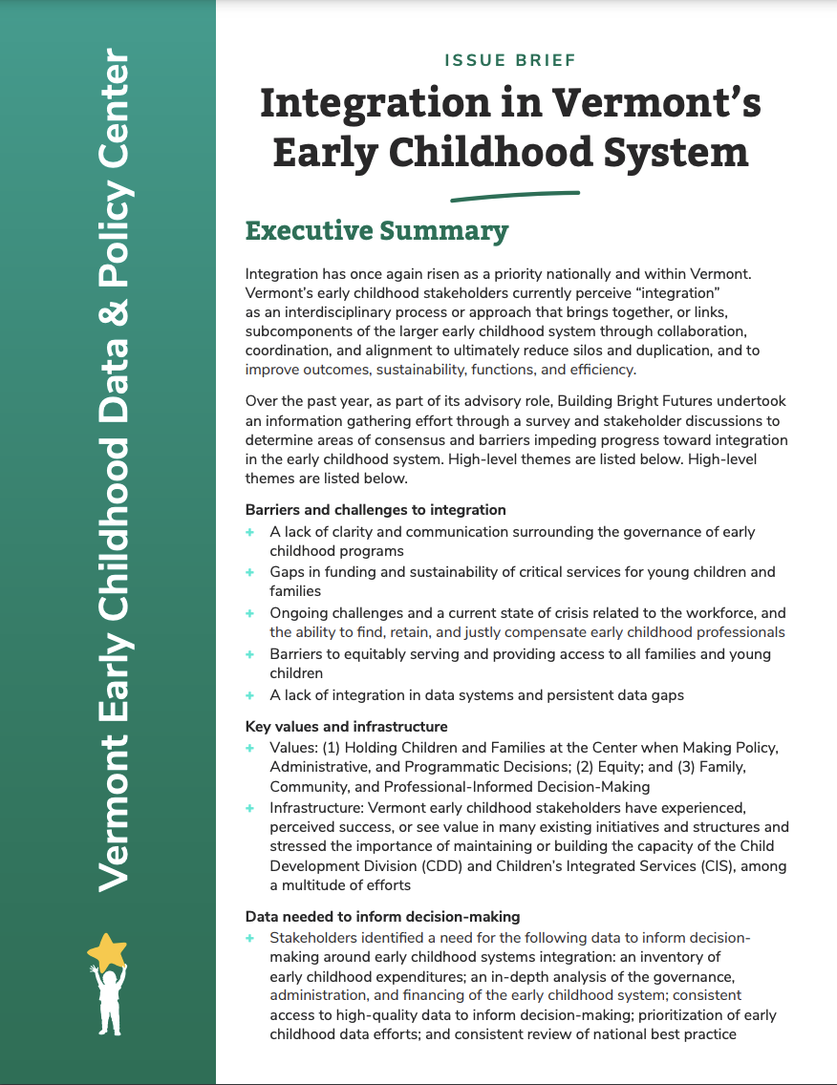
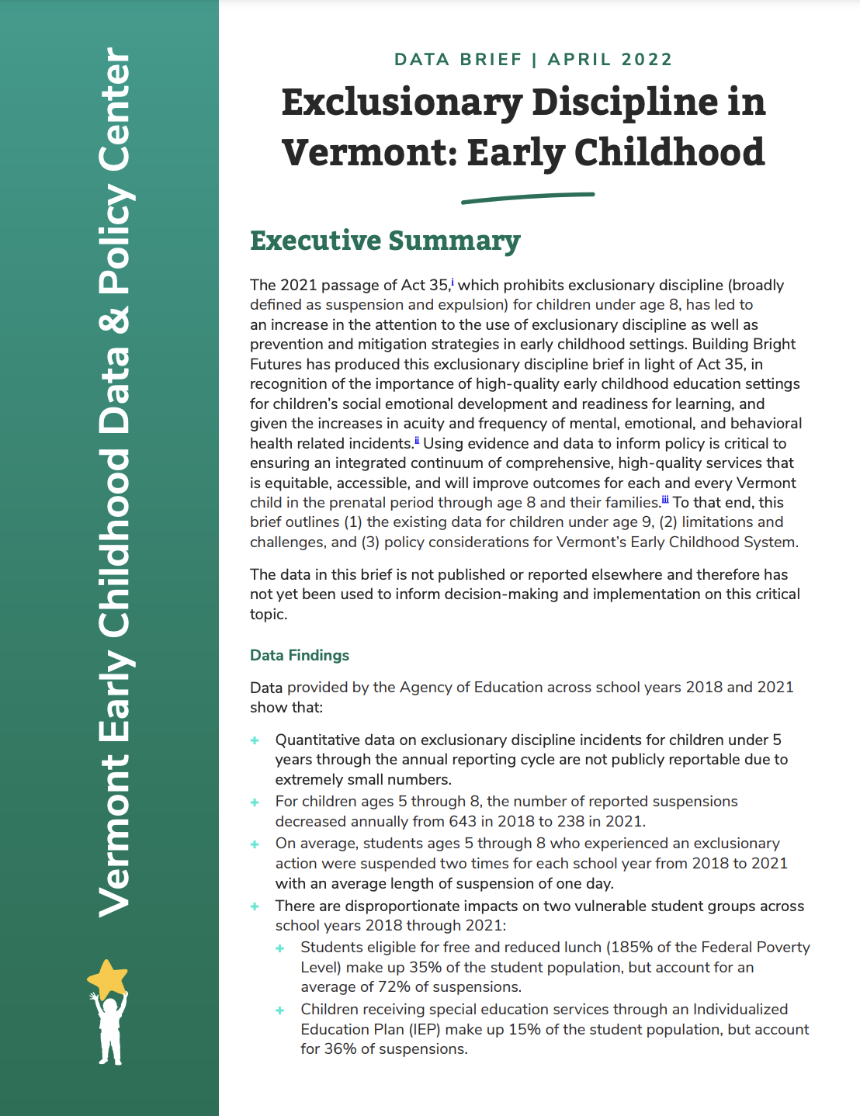
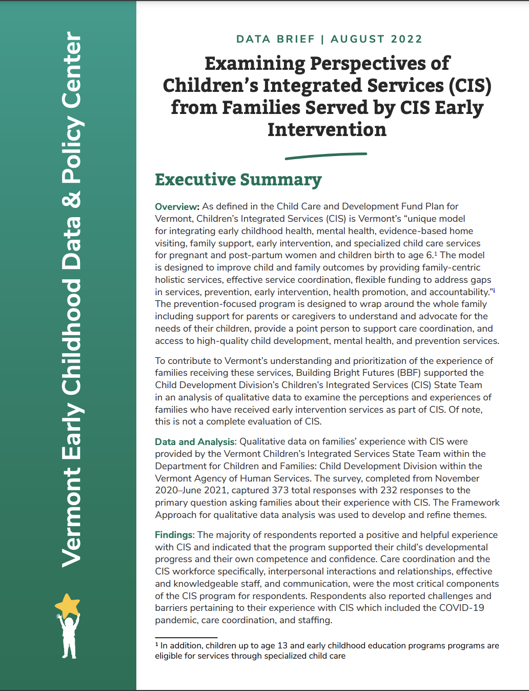
The State of Vermont’s Children
2024 Year in Review
Celebrating 12 Years of Data to Inform
Early Childhood Policy & Decision-making
Presented by Building Bright Futures and
Vermont’s Early Childhood Data & Policy Center
Monday, January 13, 2025

Slide 2
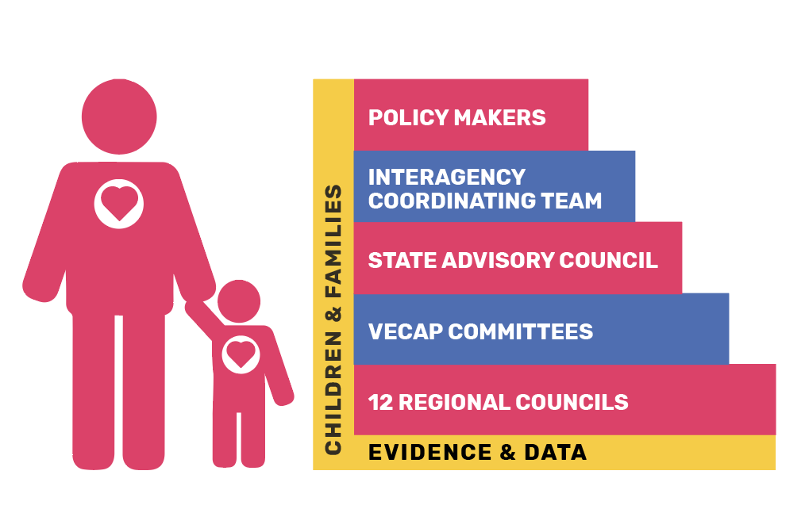
Building Bright Futures Early Childhood Infrastructure and 500+ Person Network
The Building Bright Futures State Advisory Council Network is charged by Title 33, Chapter 46 monitor Vermont’s early childhood system and to serve as an accountability mechanism.

Slide 3
Data-driven Decision-making and Accountability
BBF serves as a broker of high-quality up-to-date data and a trusted advisor.
The State of Vermont’s Children is Vermont’s most objective, comprehensive, data-driven assessment of children and families.
We are responsible for strengthening and transforming the way Vermont thinks about, and uses early childhood data.

Slide 4
Agenda
Overview of key topics from BBF’s Data Team
Basic Needs
Health and Mental Health
Early Childhood and Elementary Education
Vermont’s Child Welfare System
Child Welfare Panel Discussion
Lindsay Barron, Director of Policy and Planning, State of Vermont’s Department for Children and Families (DCF), Family Services Division (FSD)
Lauren Higbee, Deputy Advocate of Vermont's Office of the Child, Youth and Family Advocate (OCYFA)
Mercedes King, Youth Leader from the Youth Development Program
1:00 - 1:15 Questions & Discussion

Slide 5
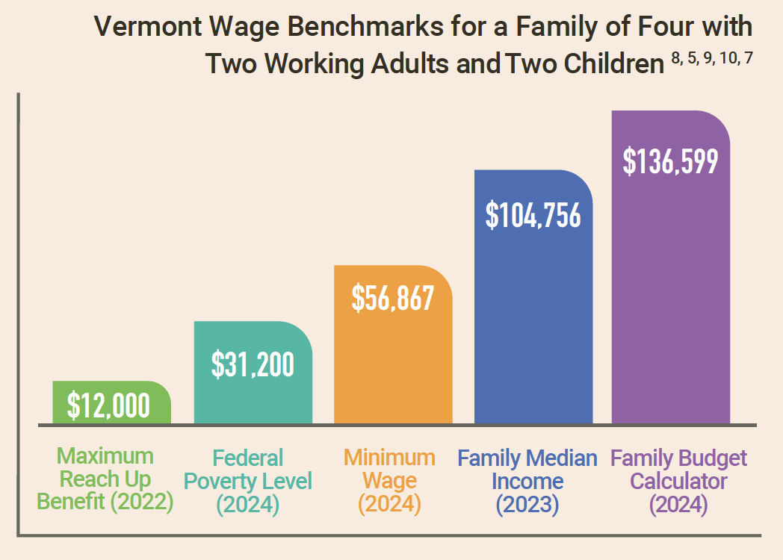
Basic Needs
Cost of Living
Income needed to meet basic needs ranges from
$103,919 in Essex County to $136,599 in Chittenden County
Basic Needs Budget does not include funds for savings, emergency expenses, or expenses like meals in restaurants

Slide 6
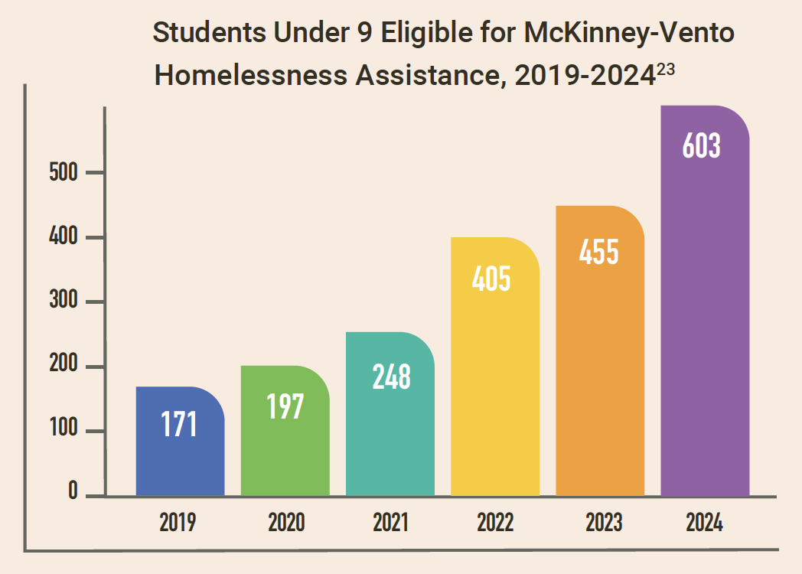
Basic Needs
Housing and Homelessness
Increase of Vermont homeless children under 9 enrolled in school from 171 in 2019 to 603 in 2024
The number of people in households with children under 18 tripled from pre-pandemic levels, from 372 in January 2020 to 1,125 in January 2025

Slide 7
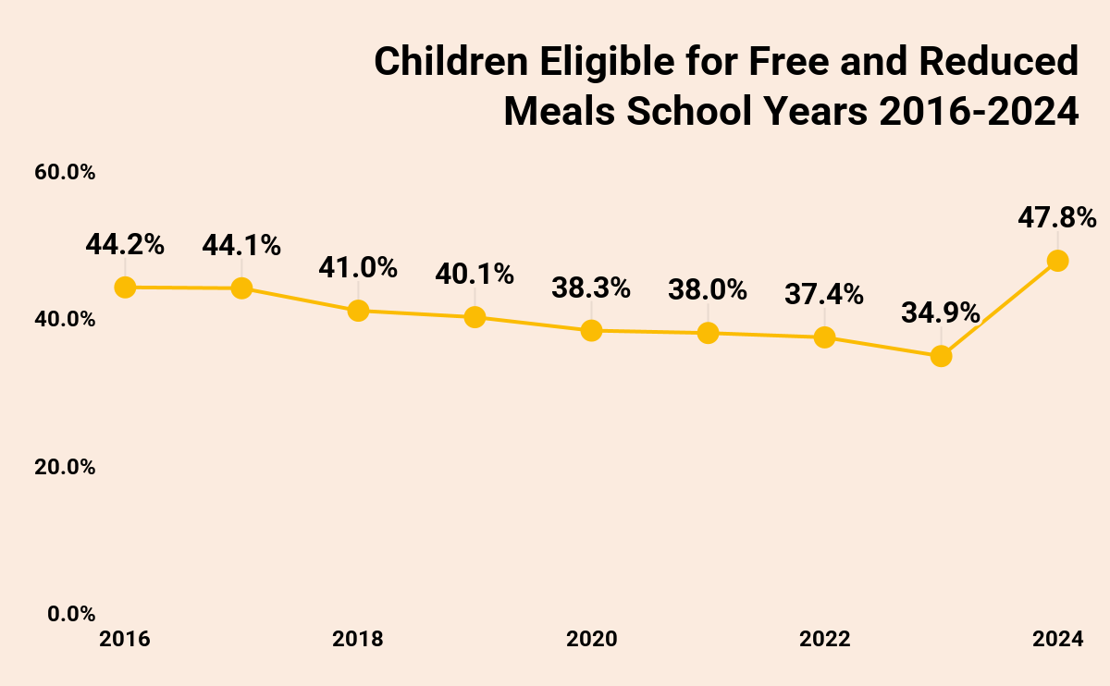
Basic Needs
Food Security and Nutrition
In the 2023-2024 school year, 47.8% of children were eligible for FRL, a 31% increase from the previous year
In 2023 the federal threshold for Community Eligbility provision decreased, increasing area-eligible schools from 89 to 240
Summer EBT received 4 million dollars in federal funds

Slide 8
Health and Wellbeing
Medicaid
Annual reviews of eligibility were paused during the COVID-19 pandemic and restarted in 2023
13% reduction in enrollment between March 2023 and September 2024
~3,000 fewer children and youth enrolled in September 2024 than September 2019
IHIP enrollment has been steadily increasing since July 2022, 340 individuals covered in September 2024
Beginning in 2023 Vermont opted to expand postpartum Medicaid coverage for qualified Vermonters from 60 days to 12 months

Slide 9
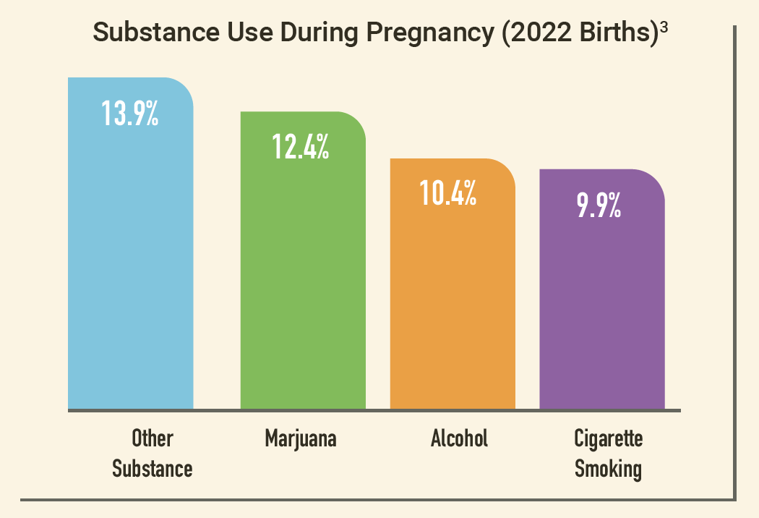
Health and Wellbeing
Perinatal Health and Substance Use
For children born in 2022, one or more substances was used during 1 in 10 pregnancies

Slide 10
Mental Health
Perinatal Mental Health
Between 2016-2022 Perinatal Mood and Anxiety Disorders (PMADs) has affected 1 in 4 pregnant and postpartum people
Screening and access to resources include the Vermont Consultation and Psychiatry Access Program, the Support Delivered campaign and increased doula services

Slide 11
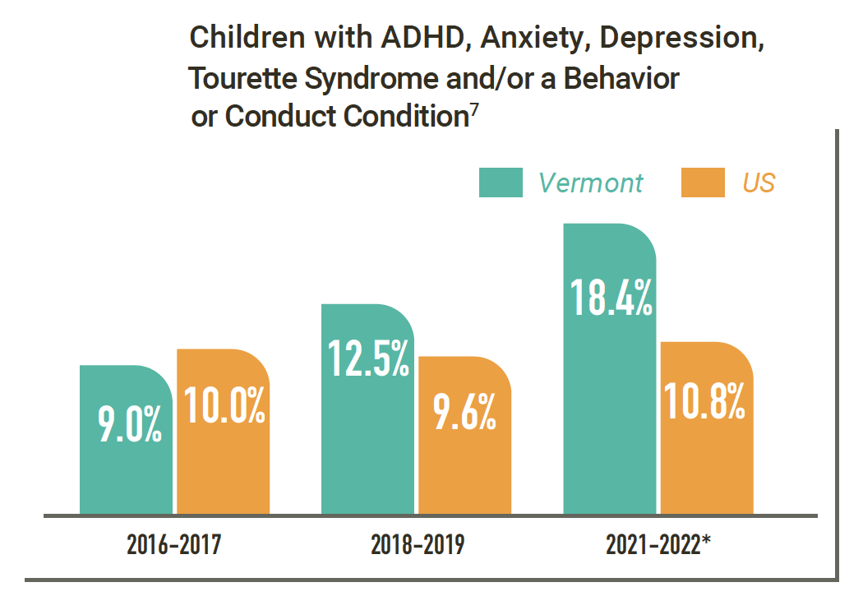
Mental Health
Mental Health for Children and Families
Statistically significant increase in the proportion of Vermont children age 3 to 8 with a diagnosis listed in chart between 2016-2017 to 2021-2022 from 9% to 18.4%
In 2024, the average turnover rate for mental health program staff at DAs and SSAs was 23%, the average vacancy rate for mental health and substance use programs was 15.3%

Slide 12
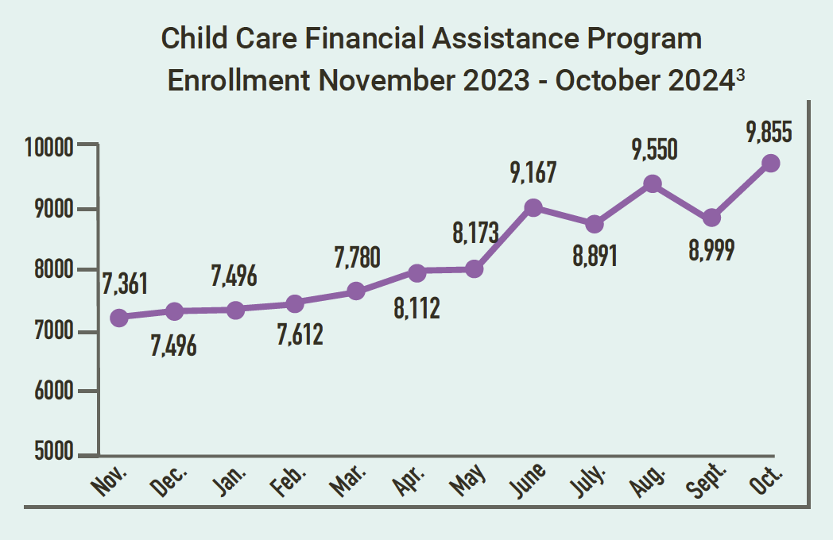
Early Childhood and Elementary Education
Act 76 and CACFP
Access to and enrollment in CCFAP expanded significantly in 2024
More information about Act 76 implementation can be found on the Child Development Division’s website and in BBF’s 2025 Act 76 Monitoring Report.

Slide 13
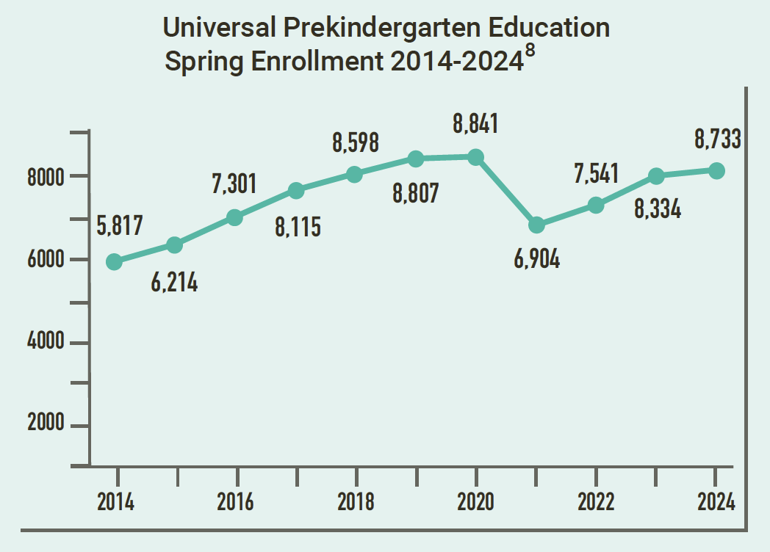
Early Childhood and Elementary Education
UPK
UPK enrollment has recovered to pre-pandemic levels, with 8,733 students enrolled during the 2023-2024 school year.
Vermont has ranked second in the country for 3-year-old access to UPK from 2017-2023.
There are currently no imminent changes to the UPK mixed delivery system for both 3 and 4-year olds.

Slide 14
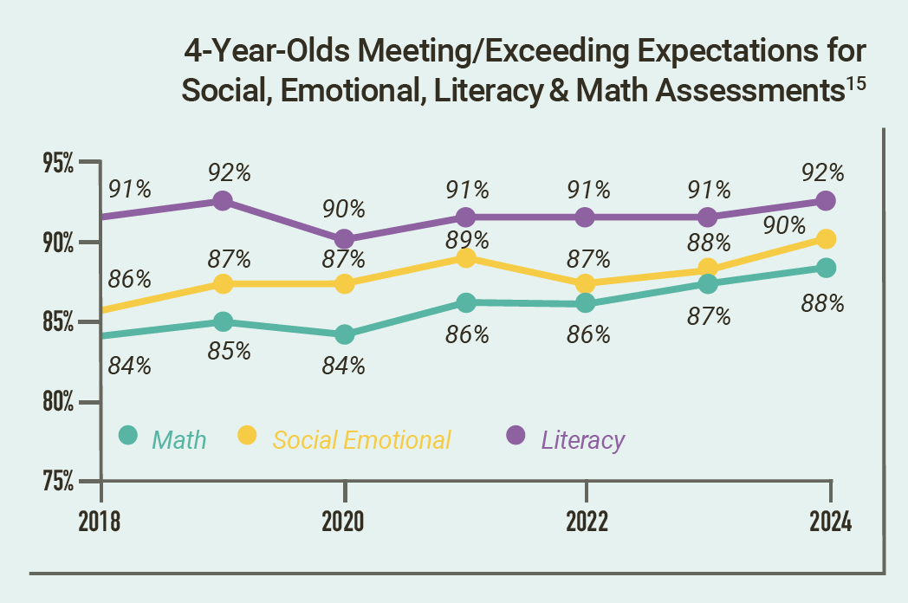
Early Childhood and Elementary Education
School Readiness
Between 2018 and 2024 there has been a positive trend for 4-year olds meeting or exceeding expectations for math and social emotional development
Vermont students age 3-5 have the highest rate of school readiness in the country, with 75.3% of children “on track”

Slide 15
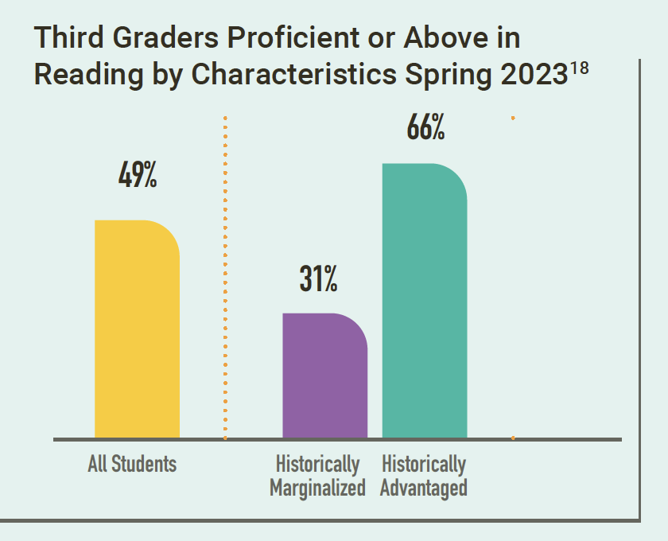
Early Childhood and Elementary Education
Third Grade Reading Assessments
For ‘historically marginalized’ students, 31% are proficient or above in reading, compared to 66% for ‘historically advantaged’ students
The percentage of students proficient or above in third grade reading from a low of 26% in Rutland City SD to a high of 71% in the Montpelier Roxbury SD

Slide 16
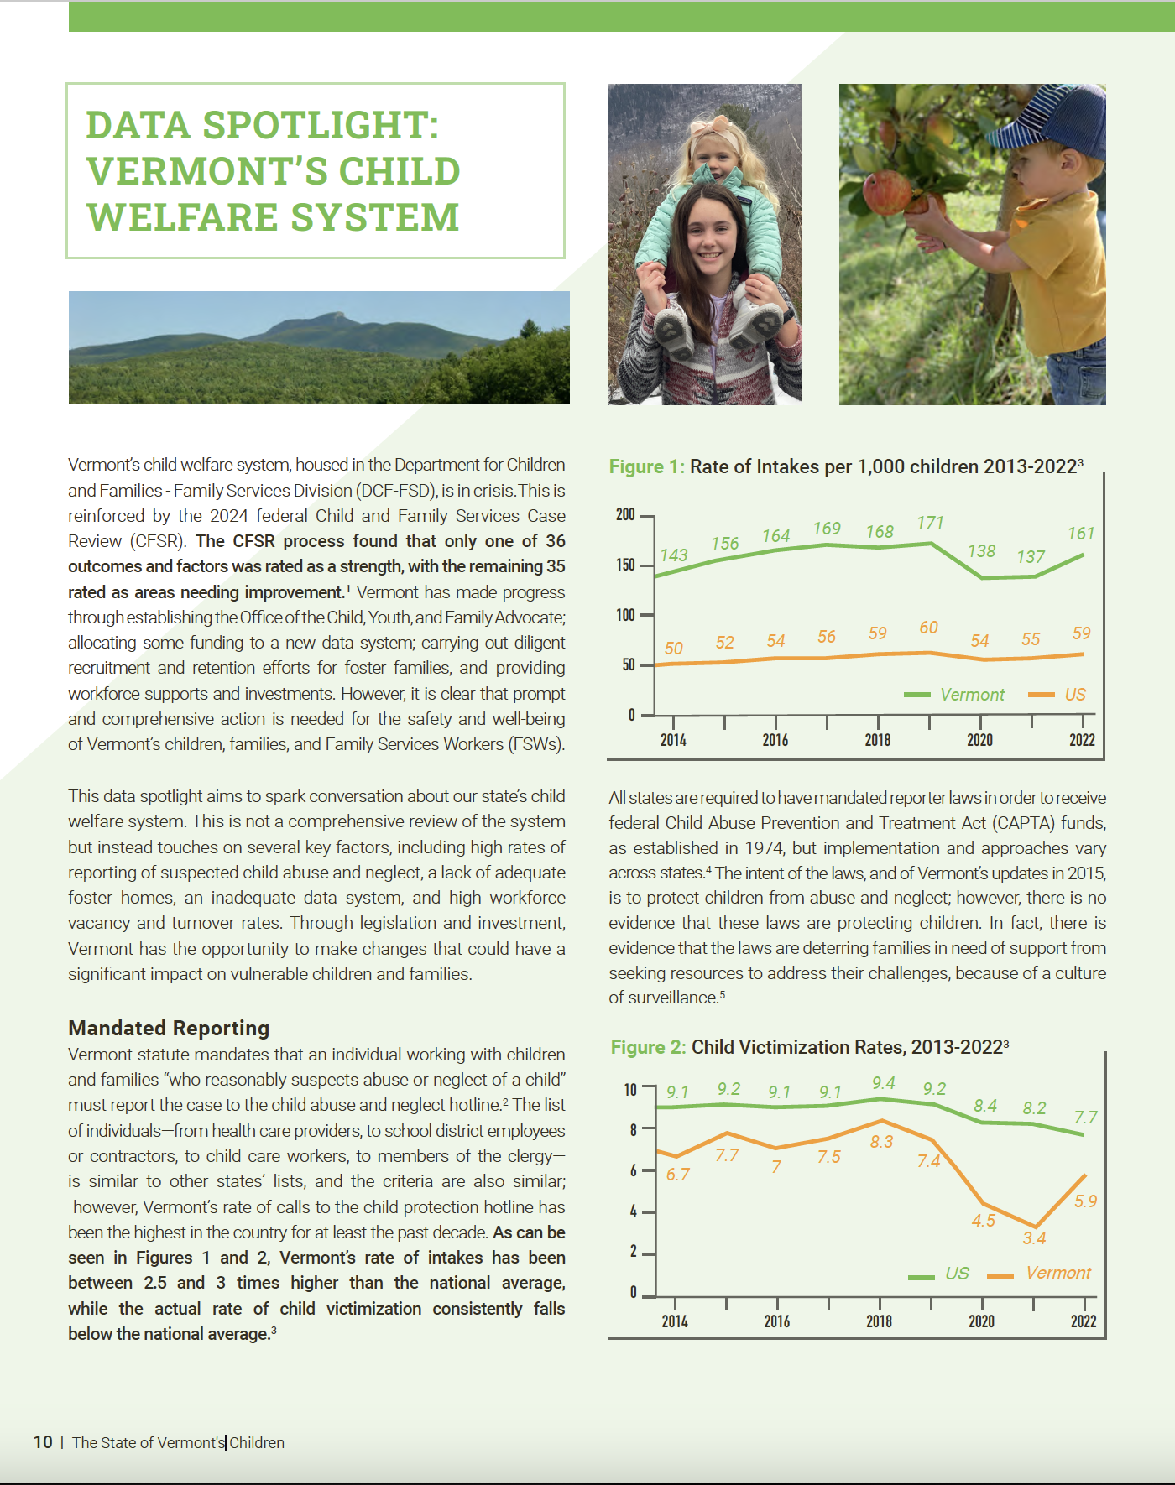
Spotlight: Vermont’s Child Welfare System
Sparking Conversation
Not a comprehensive overview of the child welfare system
Focused on children under 9
Only one of 36 outcomes and factors was rated as a strength, with the remaining 35 rated as areas needing improvement

Slide 17
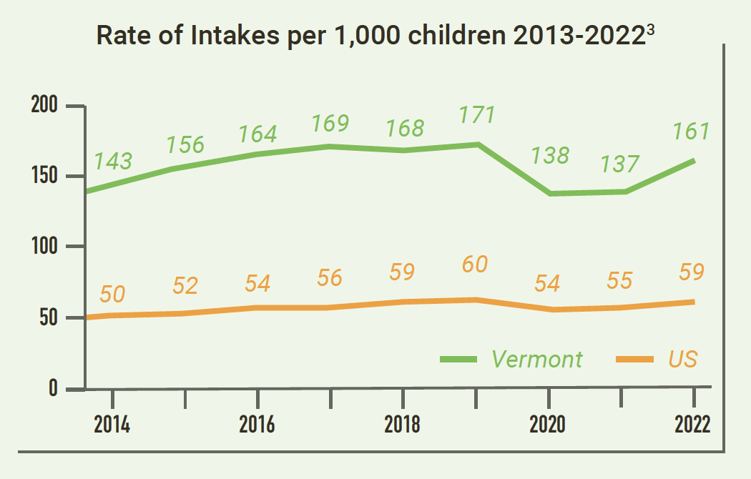
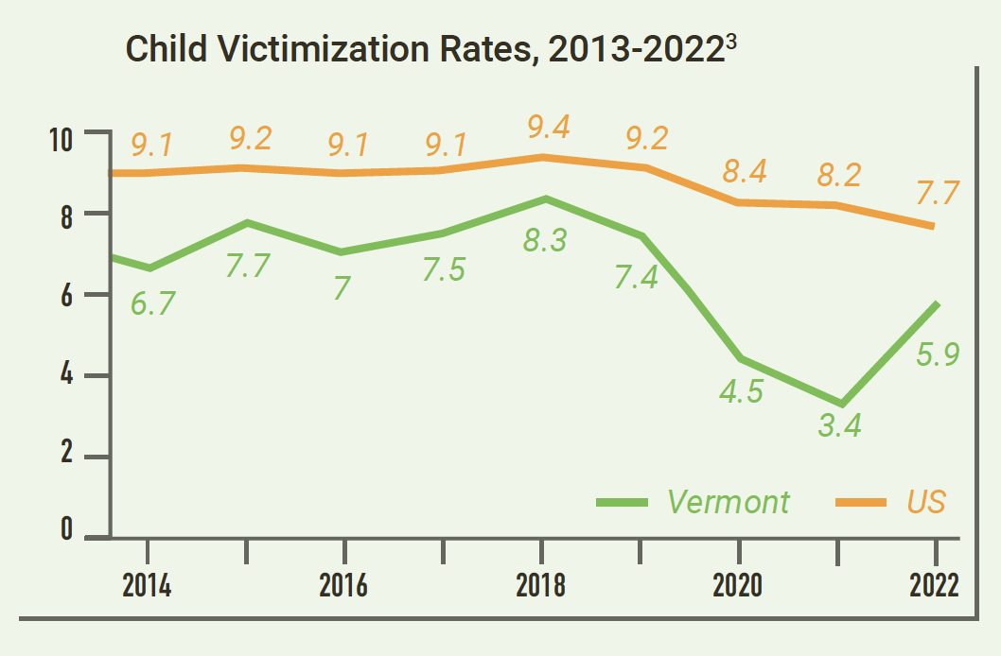
Spotlight: Vermont’s Child Welfare System
Mandated Reporting
Vermont’s rate of intakes has been between 2.5 and 3 times higher than the national average
The actual rate of child victimization consistently falls below the national average.
New training to shift from “Mandated Reporters” to “Mandated Supporters”
Child Protection Hotline - 800-649-5285

Slide 18
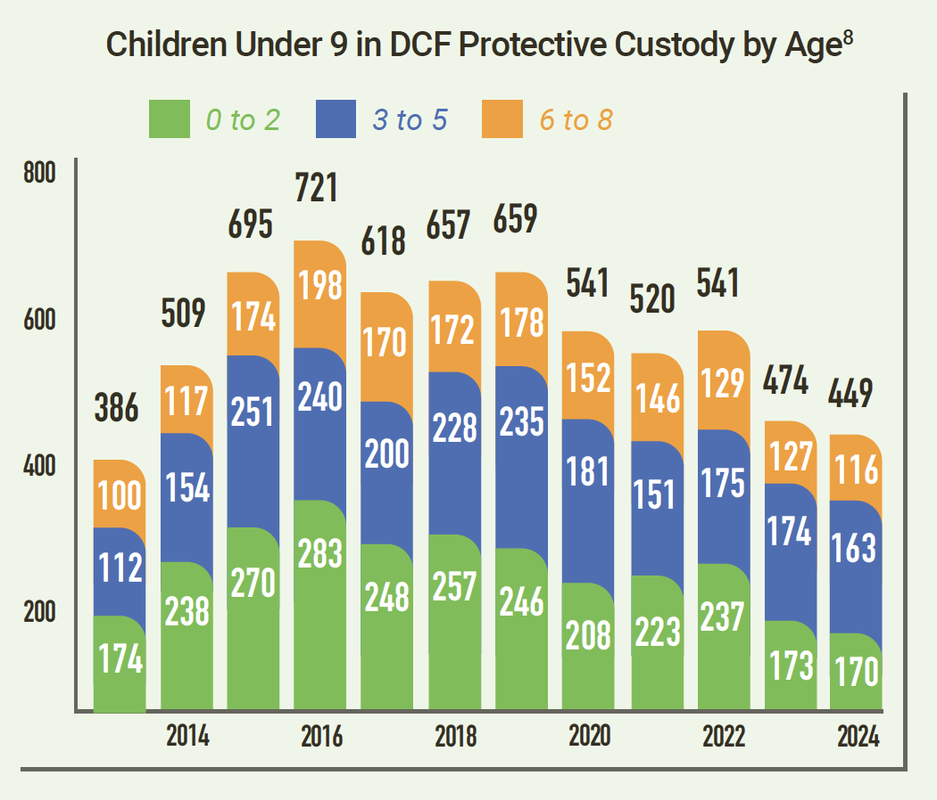
Spotlight: Vermont’s Child Welfare System
Children in Custody
Black children and youth accounted for 2.1% of the population under 19 but entered state custody at a rate of 2.8%.
Black or African American children have the highest rate of placement instability (moves/1,000 days).

Slide 19
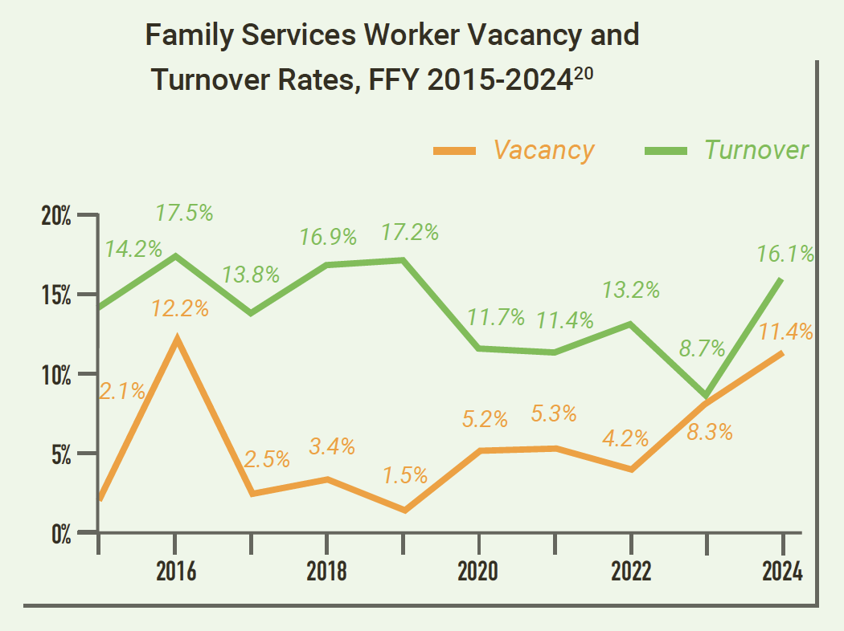
Spotlight: Vermont’s Child Welfare System
Workforce
11.4% vacancy rate and 16.1% turnover rate for Family Services Workers in 2024
Creation of two new positions and long-term intensive technical assistance

Slide 20
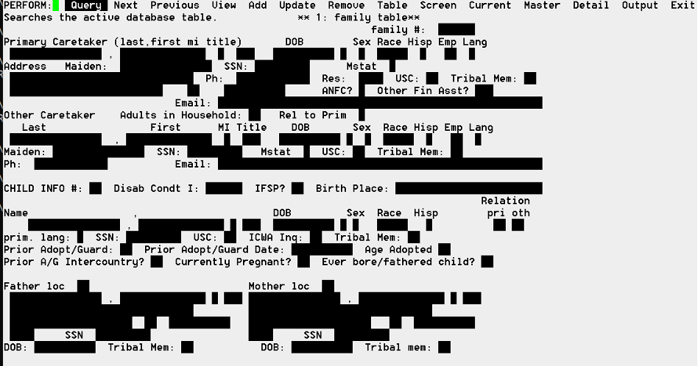
Spotlight: Vermont’s Child Welfare System
An Antiquated Data System
Data system from 1983
$40 - $50 million estimate for a new Comprehensive Child Welfare Information System (CCWIS)
$15.6 has been allocated (including a 50% federal match)

Slide 21
Spotlight: Vermont’s Child Welfare System
Policy Recommendations of the Vermont Early Childhood State Advisory Council Network
Support those Navigating the Child Welfare System by
Investing in System Improvements
Secure sufficient state funding to fully implement the Comprehensive Child Welfare Information System (CCWIS). Renewed Policy Recommendation (2024)
Utilize the Family Services Division’s federal case review report and program improvement plan to make data-informed programming and financing decisions to improve the systems serving young children in Vermont’s foster care system.

Slide 22
Spotlight: Vermont’s Child Welfare System
Expert Panelists
Mercedes King, Youth Leader from the Youth Development Program
Lauren Higbee, Deputy Advocate at the Office of the Child, Youth and Family (OCYFA)
Lindsay Barron, Policy Manager at the Department for Child and Families - Family Services Division (DCF-FSD)

Slide 23
The State of Vermont’s Children
2024 Year in Review
www.buildingbrightfutures.org
Download or request a free hard copy

